Slide 1

Random Forest Predictive Multi-Tool
By: Pranav, Dipendra, Mustafa, Jack, Anthony

Slide 2
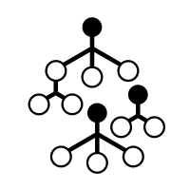
Platform for Quick Random Forest Analysis
Overall, our idea is to create a easy to use tool for anyone that wants to quickly analyze their data using a random forest model.
Motivation:
Prediction model can be important for both “Seller” and “Buyer”
Informed Decisions
Determining average pricing
Market volatility

Slide 3
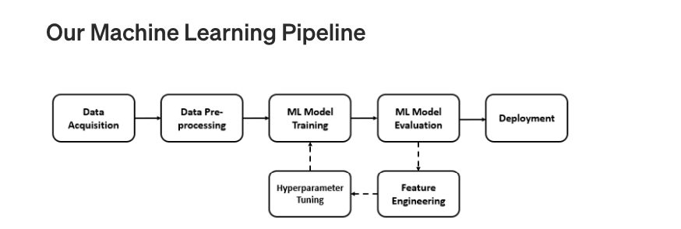
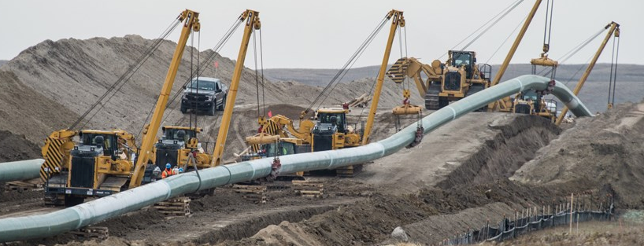

Abstract-Flow
Data Acquisition
Data Pre-Processing and Exploratory Data Analysis
Creating a Base Model
Feature Engineering
Hyperparameter Tuning
Final Model Training and Evaluation

Slide 4
RFMT
Step 1: Input Training Data
Step 2: Input Test Data
Step 3: Quickly Look at Predicted Results
Libraries used: pandas, numpy, sklearn, ipython, ipywidgets

Slide 5


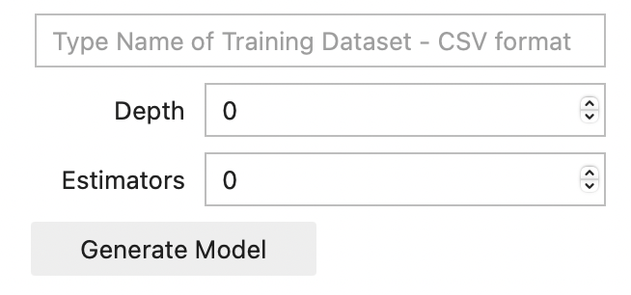
1. Input Training Data
Users are given a format in which they can plug-in their data to be quickly analyzed.
Expectations:
Data -Data is clean and has relevant features
Format
-Data is saved in a .CSV format
Look at model accuracy score before proceeding

Slide 6
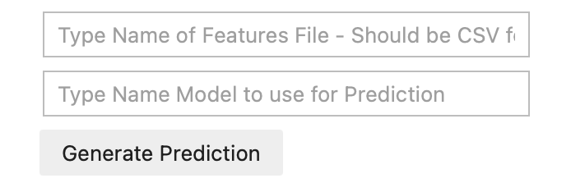
2. Input Test Data
Users are given a format in which they can plug-in their test data
Expectations:
Data is formatted to features file format provided -Data is clean and has relevant features
Pick desired model to be used for predictions

Slide 7
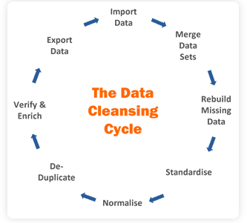
Data Cleaning Service
Data cleaning lays the groundwork for efficient, accurate and effective data analysis. Without cleaning data beforehand, the analysis process won’t be clear or as accurate because the information in the dataset will be unorganized and scattered. Good analysis rests on clean data–it’s as simple as that.

Slide 8

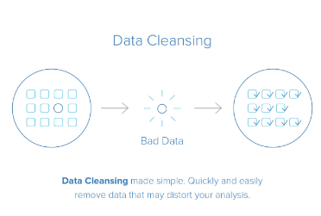
RFMT Token
Users wanting to use the Data Cleaning Service will pay for access by purchasing our RFMT token.
Service:
-Discovering
-Structuring
-Data scrubbing
-Enriching to augment the data
-Validating
-Publishing and allowing for downstream analysis

Slide 9
Post Mortem

Slide 10

Thank You For Listening .

